Slide 1

S.M.A.R.T
https://www.youtube.com/watch?v=1-SvuFIQjK8&index=30&list=WL

Slide 2
Example of a Goal
I will increase the amount of fruit I eat each day.

Slide 3

S= Specific (What)
S= Specific
I will eat at least 5 servings of fruit each day.

Slide 4
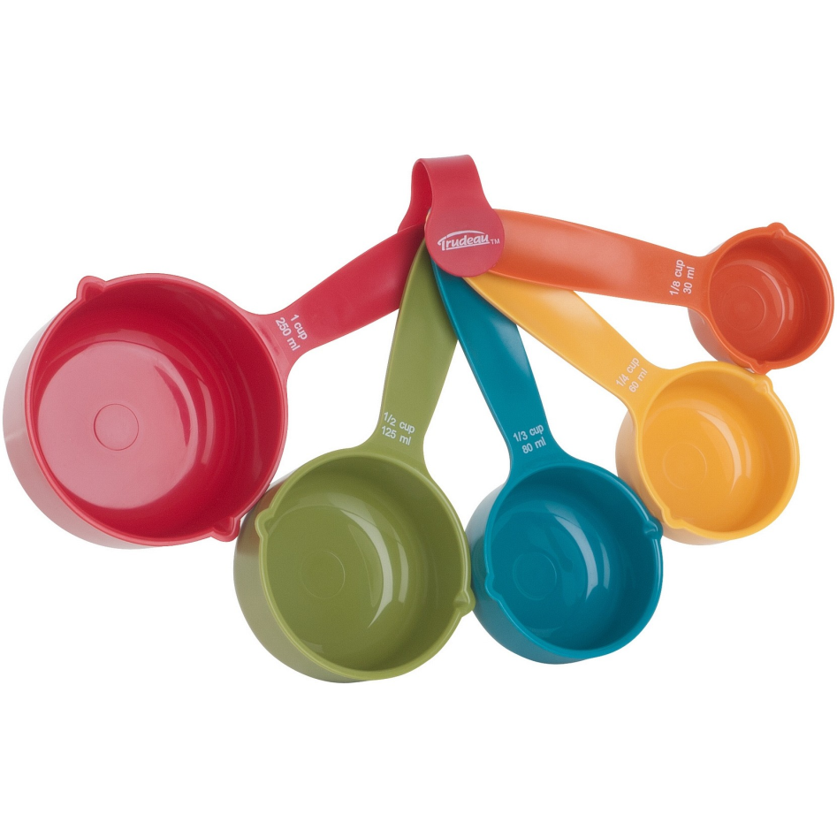
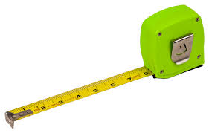
M=Measurable (Log it!)
M=Measurable
Measure with measuring cup and write down how much of what fruit I eat each day.
Log it!

Slide 5
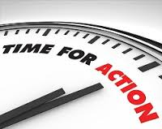
A=Actionable (How)
A=Actionable
I am going to start by eating 1 pieces of fruit at 1 meal, then adding 1 more at a different meal each week.

Slide 6


R=Realistic (Can you do it?)
R=Realistic
Adding 1 fruit per meal throughout the day.
Breakfast, lunch, snack, dinner, and snack=5.

Slide 7
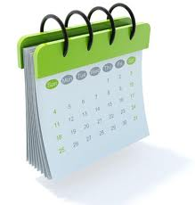
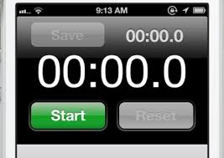
T=Timely (By when)
T=Timely
1st week I will add 1 fruit to breakfast.
2nd week add 1 to lunch also.
3rd week add 1 to afterschool snack.
4th week add with dinner.
5th week add to bedtime snack.

Slide 8


Slide 9
Example of a SMART goal
Goal: I will eat at least 5 servings of fruit and vegetables a day.
Specific
•Eat 1 piece of fruit at breakfast this week.
•Next week add vegetable to lunch.
Measurable
•Measure with measuring cup and write down how much vegetables and fruit I eat each day. Log….
ACTIONALBE Achievable/Attainable
•I am going to start by eating 1 pieces of fruit or vegetable a day, then adding 1 more per week.
Relevant
•Actually adding more fruit and veggie throughout the day.
•Breakfast, lunch, snack, dinner, and snack.
Timely
•This week I am going to add 1 more fruit or veggie, next week add 2, then 3, 4 and 5. =5 after 5 weeks!

